Slide 1
SCIENTIFIC POSTER DESIGN
Miha Klasinc • The Mind • Fall 2017 • NYU Abu Dhabi

Slide 2



EXAMPLES

Slide 3
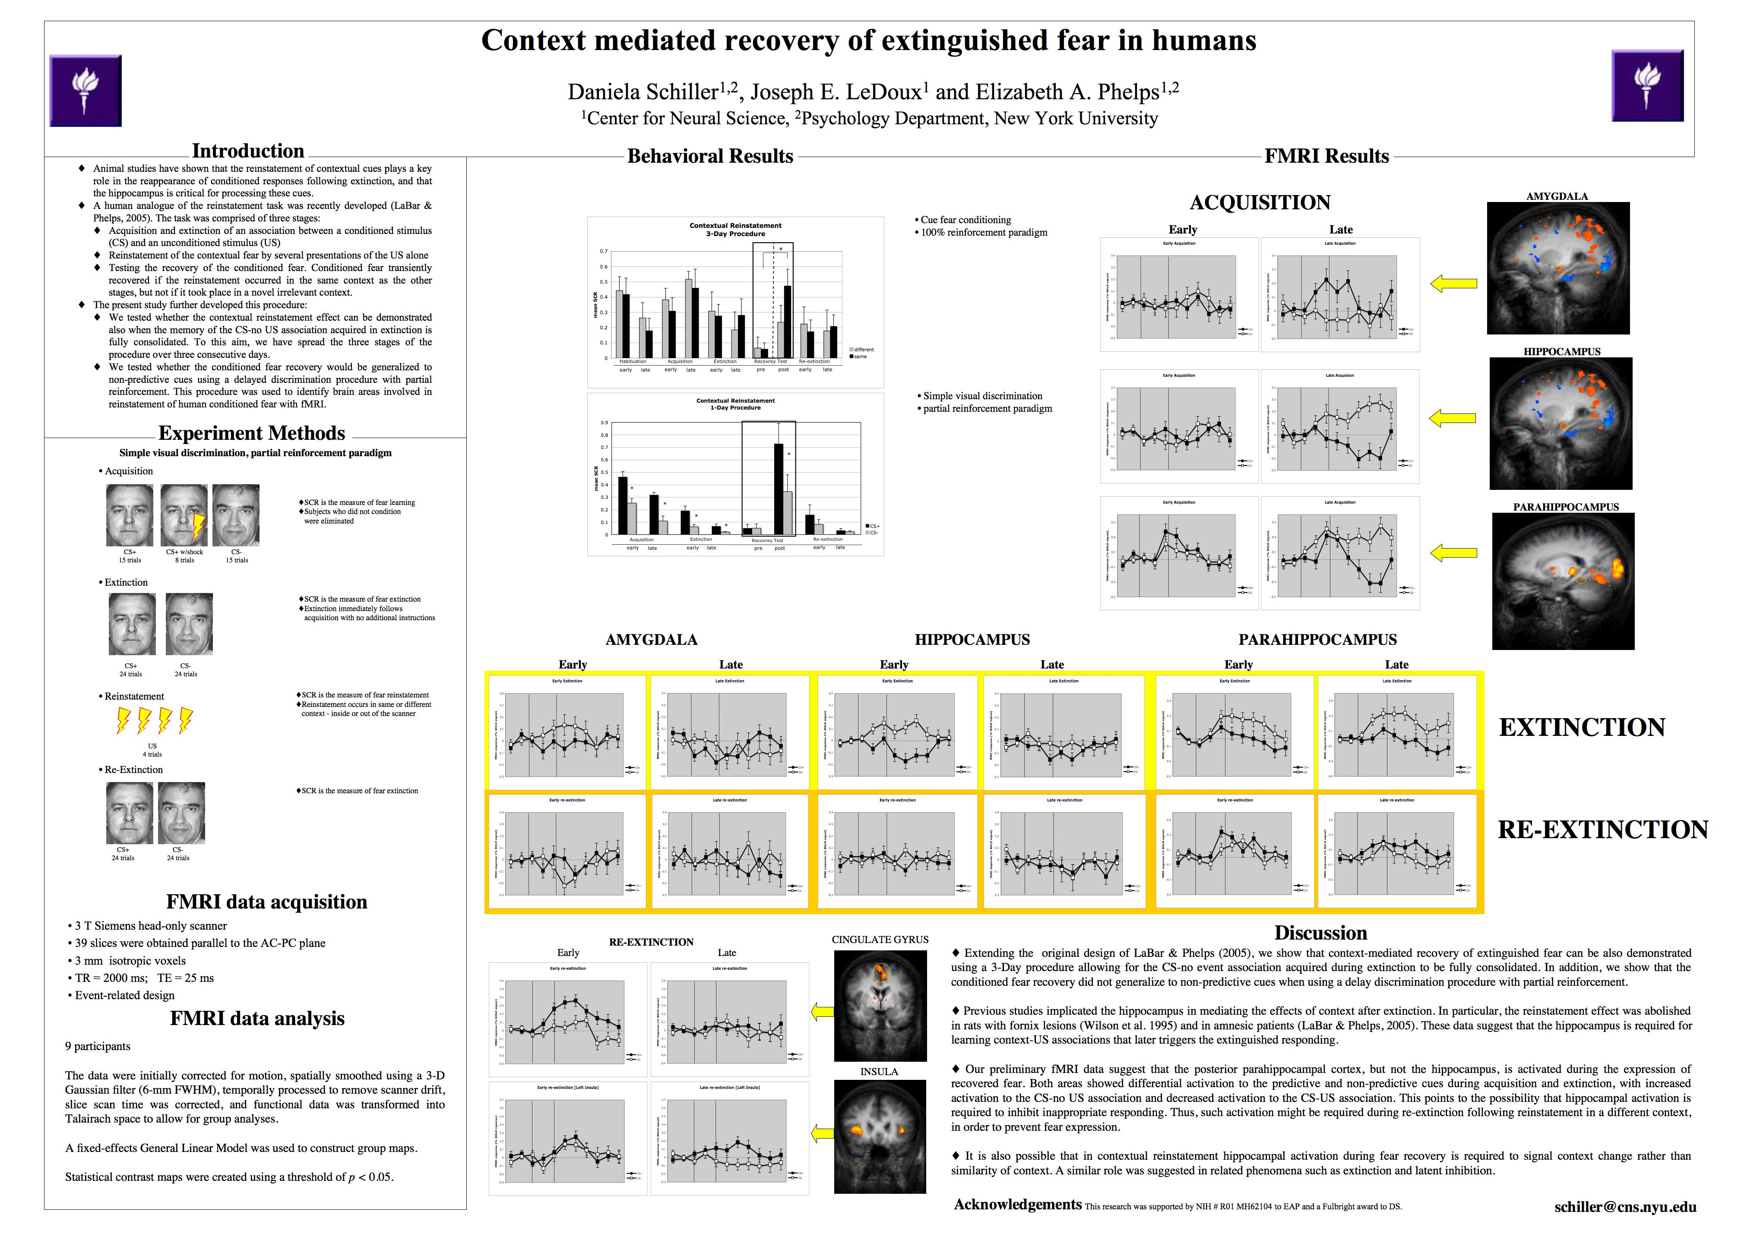

Slide 4


Slide 5
Adobe InDesign

Slide 6
Adobe InDesign
Why?

Slide 7
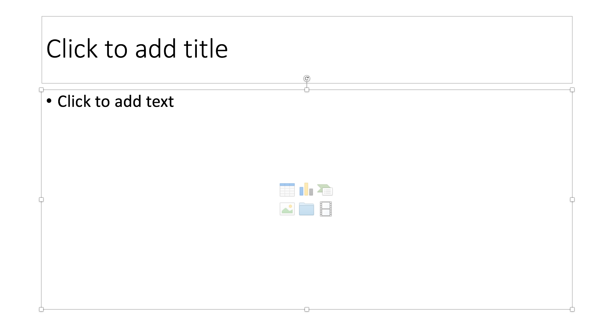
Powerpoint

Slide 8
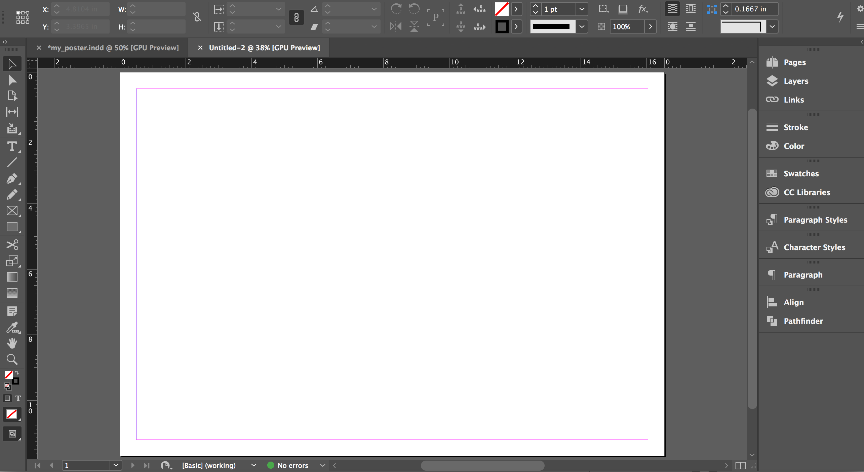
InDesign

Slide 9
Alternatives
PowerPoint
Google Slides
…

